Slide 1
BLUETOOTH - BASED HOME AUTOMATION USING ANDROID MOBILE

Slide 2
GROUP MEMBERS
M.BHUVANA - 20BTRCO007
P.HARSHITHA - 20BTRCO008
S.A.PRANAY VARMA - 20BTRCO012
Y.MAHENDRA - 20BTRCO011

Slide 3
INDEX
*Abstract
*Introduction
*Literature Review
*Existing Method
*Drawbacks
*Proposed Method
*Advantages
*Hardware and Software Requirements
*Conclusion

Slide 4
WHAT IS HOME AUTOMATION SYSTEM
Home automation is the automatic control of electronic devices in your home. These devices are connected to the Internet, which allows them to be controlled remotely. With home automation, devices can trigger one another so you don’t have to control them manually via an app or voice assistant. For example, you can put your lights on schedules so that they turn off when you normally go to sleep, or you can have your thermostat turn the A/C up about an hour before you return to work so you don’t have to return to a stuffy house. Home automation makes life more convenient and can even save you money on heating, cooling and electricity bills. Home automation can also lead to greater safety with Internet of Things devices like security cameras and systems.

Slide 5
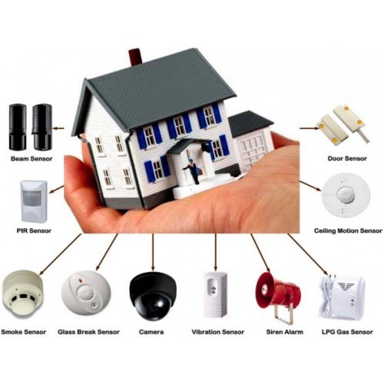
APPLICATIONS

Slide 6
ABSTRACT
Implementation of Home Automation using the latest technology gives us more convianence , security and safety. Smartphone affordability increases every year and smartphones have begun to play important roles in our daily lives due to their size and portability. Google's Android operating system (OS) is one of the leading and most preferred smartphones. Controlling home appliances by using an Android phone gives users the ability to control their appliances anywhere and anytime while at home and saves time spent in searching for remote control unit of Home Automation systems since the user's phone is usually kept close at hand. This project presents the design and implementation of a low cost prototype of a Bluetooth – based Home Automation System using android using an android phone. The design uses an Arduino Mega 2560-R3 board and the home appliances are physically connected to input/output ports of this board via relays . Cytron Blue Bee is used to establish wireless communication between them. Bluetooth Home, an Android application, is developed to provide a user friendly graphical user interface (GUI) for the remote control of home appliances.
KEYWORDS – Home Automation; Android; Bluetooth

Slide 7
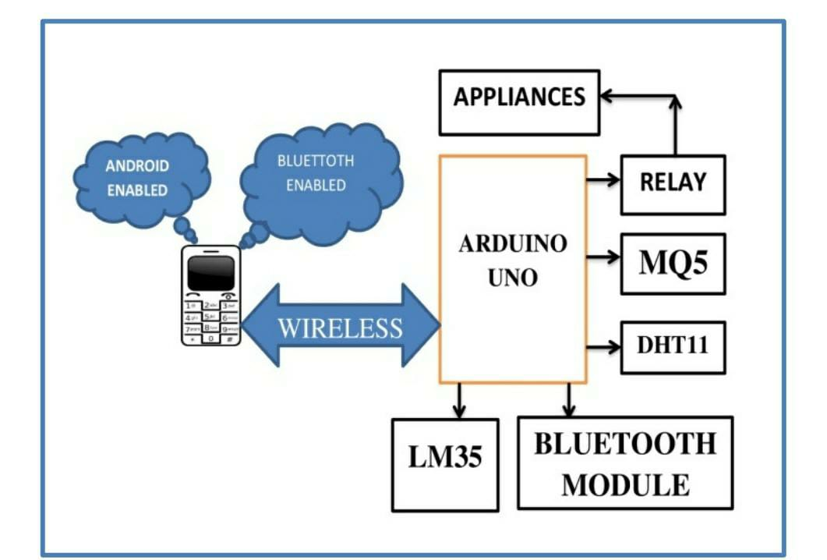
INTRODUCTION
*In this project use Bluetooth to control the appliances.
*Bluetooth technology have been enhanced to provide for higher speed data transmission service through the use of more advanced modulation technology.
*This increases the gross data transmission rate to 2 Mbps or 3 Mbps dependent on which Bluetooth device.

Slide 8
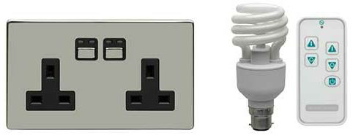
Home automation systems are implemented to increase user convenience in the control of home appliances either via wired or wireless communication. The word “wired” means that the home appliances are physically connected to a server or central controller to the home automation system, while “wireless” means that home appliances are connected wirelessly to a server or central controller or remote control unit. Light waveRF is a home automation systems company that utilizes a wireless connection between the remote control unit and home appliances. Figure 1 shows the Light waveRF “smart” power socket and remote control unit.

Slide 9
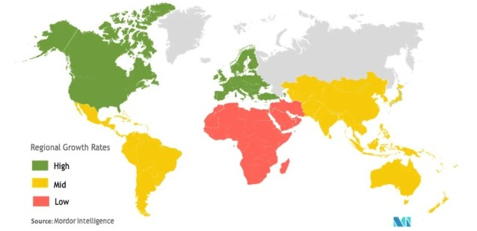
Home appliances such as TVs, DVD players, air conditioning and other devices come with their respective remote control units. When a home automation system is installed, there is the addition of at least one more remote control unit [7].
Nowadays, people are inseparable from their smartphones. A total of 5000 people from the US, UK, China, India, South Korea, South Africa, Indonesia and Brazil took a smartphone survey which was organized by Time magazine. This survey found that the majority were highly attached to their phones, whereby 84% claimed that they could not go a single day without their phones [8].
Android [9] has 75% worldwide of the smartphone market share and a total of 136 million Android phones were sold in the third quarter of 2012 [10]. Android has become the top mobile gadget operating system (OS) on the market today. In other words, the Android phone has become the most popular and commonly used OS in society.

Slide 10
LITERATURE REVIEW
Home automation or domestic robotics (domotics) is a combination of automation technologies and computer science [7]. High affordability and connectivity through smartphones and tablets has increased the popularity of home automation in recent years [10–12]. The life quality of the elderly and disabled can be improved by using home automation. Radio frequency (RF) is one of the techniques used in the home automation network to control and monitor home appliances.

Slide 11
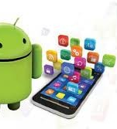
ANDROID OS
Android OS is open source based on the Linux kernel with a Java programming interface, designed primarily for touchscreen gadgets [12]. The Android phone has been on the market since October 2008. Device manufacturers, wireless carriers and enthusiast developers are allowed to modify and distribute the software under the Apache License [12].
Google Play is Android’s primary application store. There were approximately 700,000 applications available for Android in October 2012, developed by a large community of Android application developers.

Slide 12
BLUETOOTH TECHNOLOGY
Bluetooth technology is a low-power-consumption short-range wireless communications technology [13] and operates in the unlicensed industrial, scientific and medical (ISM) band at 2.4 GHz to 2.485 GHz [14]. The 2.4 GHz ISM band is available and unlicensed in most countries. Pairing uses two Bluetooth enabled devices known to each other [2]. Table 1 shows the types of Bluetooth.

Slide 13
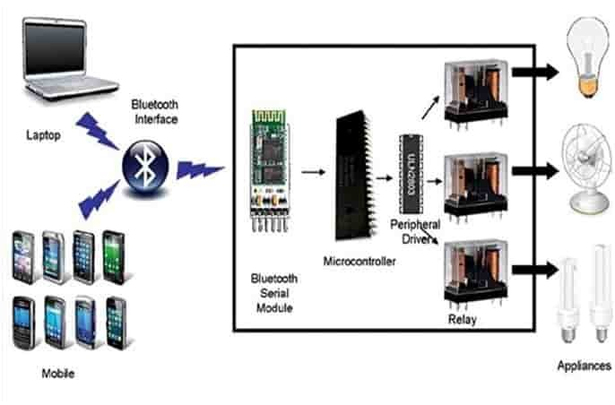
ANDROID MOBILE USING BLUETOOTH

Slide 14
TYPES OF BLUETOOTH
BLUETOOTH CLASS
RANGE
Class 1
Class 2
Class 3
100 meters
10 meters
1 meter

Slide 15
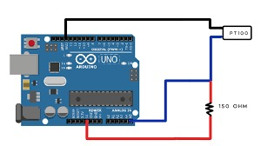
Arduino
Arduino is an open source physical computing platform based on a microcontroller board and an integrated development environment to program the board [15, 16]. Arduino acquires several inputs such as switches or sensors and controls several outputs such as lights, motors and others. Arduino software is compatible with the Windows, Macintosh and Linux OSs unlike most microcontroller systems that are limited to Windows. Arduino programming is simple for beginners. It is good for students to know how to use it since many applications use Arduino [17].

Slide 16
METHODOLOGY
This project consists of two parts: hardware implementation and software development.
SYSTEM DESIGN
This project utilizes two types of communication: wireless and wired. Cytron Blue Bee, which is a Bluetooth module, is used to enable the controller to wirelessly communicate with an Android phone[18]. The home appliances are physically connected to the controller via relays. The Android phone sends a signal to the controller. The signal received is processed and controls the home appliance accordingly. At the same time, the controller sends the status (ON/OFF) of the home appliance to the Android phone.

Slide 17
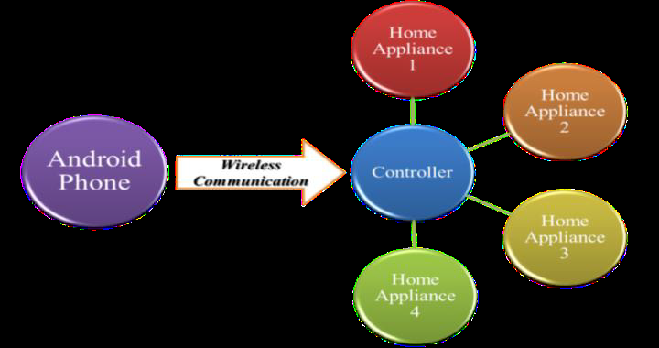

Slide 18
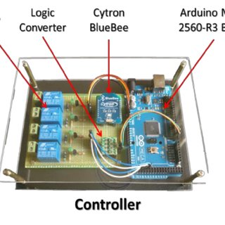
HARDWARE IMPLEMENTATIONS
This section describes the implementation of the controller. The controller is integrated using an Arduino Mega2560-R3, cytron Blue Bee, logic converter, relays and other electronic components. Figure 4 shows the controller design.
* The four components used in this project are:
i. Arduino Mega2560-R3.
Ii. Cytron Blue Bee.
iii. Single Pole Double Throw Relay 0-5V.
iv. Logic Converter four Channels.

Slide 19
SOFTWARE DEVELOPMENT
This section describes Arduino programming and Android application development. The controller is programmed in C using Arduino IDE. The Android application is developed in Java programming using Eclipse IDE.

Slide 20
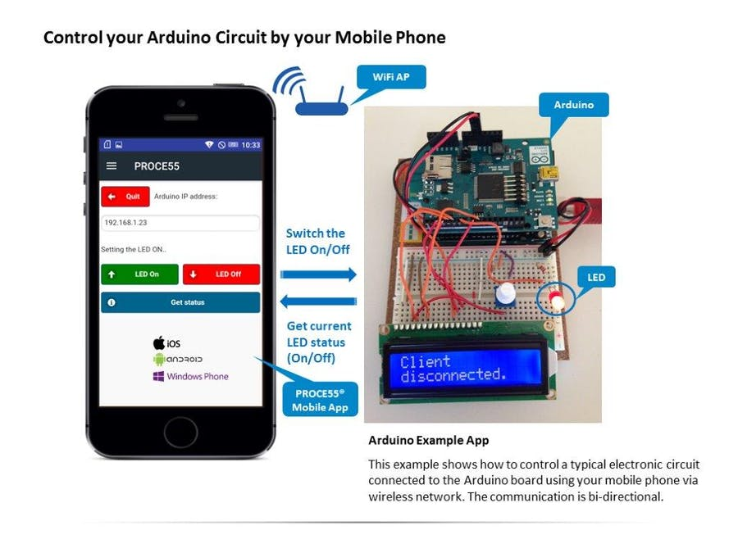
ARDUINO PROGRMMING
The baud rate of Arduino Mega2560-R3 is set to the baud rate of Cytron Blue Bee which is 9600 using the Serial. begin( ) function. Four digital pins (46, 48, 50, 52) are assigned as the output pins using the pin Mode( ) function. The Serial. available( ) function i used to check for any data received. Returning a value greater than zero means that data has been received. This data received is read by the Serial. read( ) function and stored in the incoming Byte buffer. The output pin is set to low or high using the digital Write( ) function. Data is sent to an Android phone using the Serial. println( ) function.

Slide 21
ANDROID APPLICATION DEVELOPMET
The Smartphone used throughout this project was a Sony Xperia P with Android OS version 2.3.7 (Ginger Bread). The Android application was developed in Java programming using Eclipse IDE with Android platform API8: Android 2.2 (Froyo), the lowest Android version that the application can support. More devices can be supported with lower API levels but with fewer features. It was important to make this decision before development because the application is unable to run on a platform below the Android 2.2 OS. Bluetooth Home is the Android application developed to control home appliances

Slide 22
LIMITATIONS AND PROBLEMS ENCOUNTERED
* Some problems were encountered during this project. Bluetooth connection of the Android application could not be established in the early stages of this project. This problem was solved after referring to the online solution on Android Bluetooth APIs. In addition, Bluetooth Home was unable to display the data received correctly. This problem was solved by putting a flag in the data listening loop. However, another issue was that the list view is unable to display the first character (“H”) of the first data received. The list view is able to display the following data received correctly.

Slide 23
CONCLUSION
It can be concluded that the objectives of this project were achieved, ie, to develop a low cost and high reliability home automation system. In addition, a user-friendly Android application as an alternative to the remote control unit of a home automation system has also been established.
Improvements can be made to improve this project. Some recommendations are:
i. The Bluetooth connection between the Android phone and the controller is automatically established when the user starts the Bluetooth Home, provided the phone’s Bluetooth is turned on.
Ii. An LCD display is integrated into the controller to provide the status of the home appliances.
iii. Bluetooth Home is able to control TV channels, air conditioning temperatures and so on.

Slide 24
REFERENCES
[1] N. Sriskanthan, F. Tan, and A. Karande. 2002. Bluetooth Based Home Automation System. Microprocessors and Microsystems. 26: 281–289.
[2] R. E. Rahim. 2010. Controlling Home Power Socket Using Bluetooth Enabled Device. Bachelor of Electrical Engineering (Electronic), Faculty of Engineering, Universiti Teknologi Malaysia, Johor, Malaysia.
[3] P. Sánchez, M. Jiménez, F. Rosique, B. Álvarez, and A. Iborra. 2011. A Framework For Developing Home Automation Systems: From Requirements to Code. Journal of Systems and Software. 84: 1008–1021.
[4] M. Chan, D. Estève, C. Escriba, and E. Campo. 2008. A Review of Smart Homes–Present State and Future Challenges. Computer Methods and Programs in Biomedicine. 91: 55–81.
[5] R. A. Ramlee, D. H. Z. Tang, and M. M. Ismail. 2012. Smart Home System for Disabled People via Wireless Bluetooth. In System Engineering and Technology (ICSET), 2012 International Conference on. 1–4.
[6] Lighwave RF. Available: http://www.lightwaverf.com.
[7] R. N. D. Fritz. (2012, 27/12). Remote Control Units for Home Automation. Available: http://compnetworking.about.com/od/homeautomationsystems/a/remote-control-units-for-home-automation.htm.

Slide 25


